Slide 1
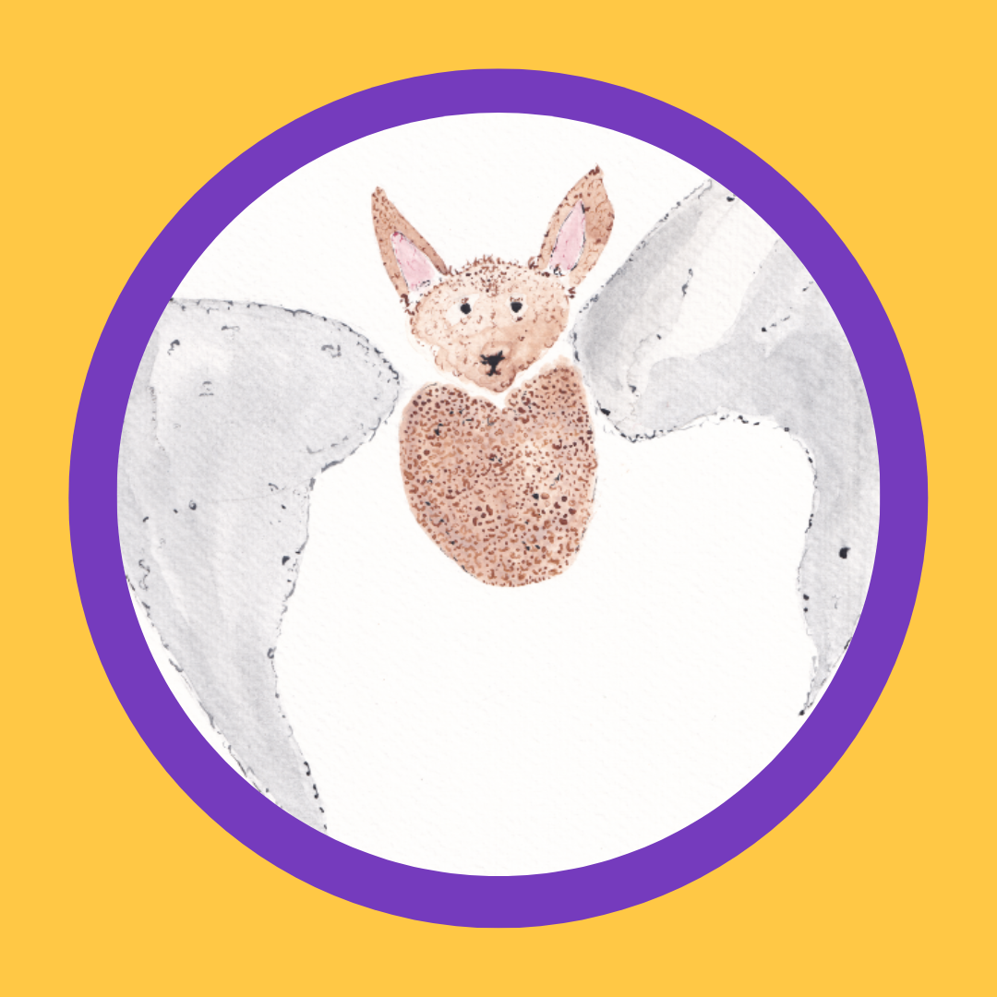
Benna Makes A Noise
Read by Jill Halfpenny
Copyright: Kidscape 2022
Registered charity no.: 326864
Illustration by Laura H Brown

Slide 2
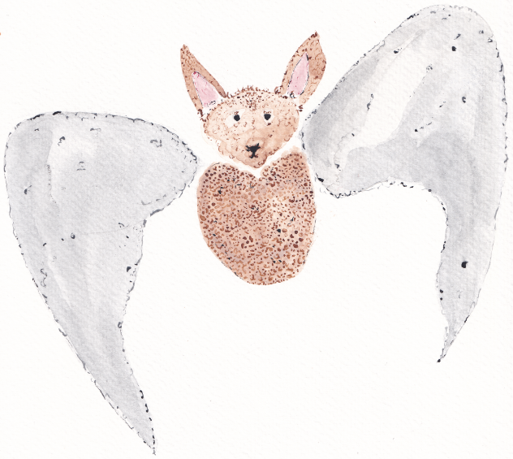
Benna Makes A Noise
Benna was a very chatty bat. She lived in a very chatty tree in a very chatty wood, and every day when she woke up, she would hear her mum and her dad and all her brothers and sisters already chatting about the tastiest bugs they were going to eat that morning. It was very noisy.
By the time they left for school, some of Benna’s family had already done enough chatting for the day. They preferred to zoom ahead or twirl round and round on the branches. But Benna wasn’t the fastest at zooming, and she sometimes got stuck when she tried to twirl around a branch, so she flew next to her dad instead and chatted to him about bat school.

Slide 3
Most of the time, Benna liked bat school. She liked practising her squeaks and learning about the biggest and best beetles to eat. But there was one thing that Benna didn’t like about bat school. And recently, that thing had been getting worse.
There was one bat, Bestie, who was the most popular bat in the whole colony. He was fantastic at flying and catching insects, and he had the loudest squeak of anyone. Sometimes he would zoom right up close behind you and screech at the top of his bat-voice, so loud that it hurt. Lots of the other bats found this very funny. They thought that Bestie was the best.
But Benna was a bit scared of him.

Slide 4
Bestie was at the entrance when they got to bat school, swooping close to other bats at great speed. Benna thought that these bats looked a bit scared, too. They didn’t want to be sent spinning through the air. She thought about telling her dad about Bestie, but her dad was waving goodbye, and before she knew it, the bat teacher had called them into the classroom.
At breaktime, Benna decided that the safest thing to do was to hang in a branch away from Bestie and the other bats. There was a tree near the edge of the playzone in a nice shady spot where you could still see everything that was going on. Normally, Benna would want to be in the middle of things and chatting to the other bats.
But when she saw Bestie come out, she was glad to be tucked away.

Slide 5
Bestie and his friends were whispering and laughing. They seemed to have made up a new game. Very slowly, so slowly you’d hardly notice, they were forming a circle around Balbir.
Balbir was the cleverest bat that Benna had ever met. He knew all there was to know about trees and the best ways to catch insects. He had a special leaf covering on his head, which was important to him and his beliefs. Bestie liked to point at the covering and laugh.
Now, Balbir didn’t seem to have noticed that Bestie and his friends were forming the circle around him. Benna watched as Bestie sneaked closer, and closer, until –
SWOOP!

Slide 6
Suddenly, Bestie dived. Benna saw a flash of white teeth. Bestie had ripped off Balbir’s leaf covering and flown off with it into the trees. All the other bats in the circle started squeaking with laughter.
Balbir put his wing to his head, and Benna could see little tears rolling down his fur. She really wanted to fly over to him, but Bestie and his friends were still laughing in the trees, and she felt too frightened, so she pretended to be eating one of her grubs as Balbir flew away.
When they flew home from school, Benna didn’t want to chat about her day.
‘What’s up, Benna?’ asked her dad. ‘Normally you love chatting!’

Slide 7
Benna hesitated. She felt scared to say anything to her dad about what had happened to Balbir. What if telling him made it worse? But her dad was looking at her with his lovely kind bat eyes, and so she told him what she had seen. She squeaked a little bit when she was saying it, because she felt so frightened.
Benna’s dad looked very shocked about what Bestie and his friends had done. He told Benna that what she’d seen was bullying, and what’s more, it had targeted Balbir’s leaf covering. He said that this was very, very wrong.
‘The bat teacher needs to know about this,’ he said.
Benna felt worried. What if that meant Bestie and his friends came for her next? Benna’s dad said he understood why she was feeling worried. But, he explained, making a noise about bullying is the way to make it stop. It’s when bats don’t make a noise that the bullying can go on and on. And sometimes, he said, it’s easier to make a noise when we’re together. We can feel stronger and safer and the noise can be much, much louder.

Slide 8
Suddenly, Benna had an idea. There were lots of bats in the class who didn’t like Bestie’s mean games. Maybe they could make a noise about it together?
‘That’s an excellent idea,’ said her dad.
The next day, Benna and Balbir hatched a plan. They whispered it together before school while they were hanging out in their favourite tree.
‘I know how we can make this work,’ said Balbir, and they giggled when he told her.
At breaktime, Bestie and his friends were up to the same old tricks. They’d seen another bat by themselves, and they were preparing to sneak up and screech.
Bestie smoothed his shiny fur, opened his mouth and SCRE –

Slide 9
SQQUUUUEEEEAAAAKK!
Bestie looked up, stunned.
SQUEAK, SQUEAK! squeaked Benna and Balbir, flapping through the air.
The other bats in the colony heard the noise. They started flapping and squeaking too.
SQUEAK! SQUEAK! SQUEAK!
And they all began to fly together, all the way to the bat teacher at the other end of the playzone.
Benna explained what had happened, and the bat teacher asked to see Bestie straight away.
‘What’s happened, Bestie?’ she asked.
Bestie shrugged his wings.
‘Just banter,’ he said.

Slide 10
The bat teacher explained that banter is very different from bullying. Banter is when everyone is in on the joke and is enjoying it. But Bestie and his friends kept picking on other bats, even when they weren’t enjoying it, and that meant it was bullying.
Bestie looked angry and Benna felt scared, but the bat teacher told everyone that they’d done a really good job in making a noise about bullying. It meant that the bullying behaviour could stop.
‘And if this happens again,’ she said, ‘you come straight to me.’
Bestie looked down and then said, sadly, ‘but I like screeching. It’s really fun.’

Slide 11
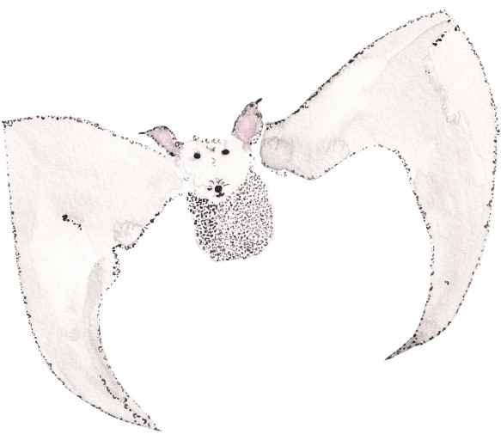
Benna could understand this. After all, she liked chatting. She found that fun, too. The bat teacher thought for a moment.
‘Making noise and screeching are really fun. Maybe we can find a way to do it together?’
Bestie and Benna and Balbir and all the other bats thought this was a great idea. The bat teacher started to arrange them. She put them in the right places so that their screeches and squeaks would sound as good as possible. And together, they raised their voices to make a noise that was very beautiful and very, very loud.

Slide 12
‘Benna Makes A Noise’ was read by Jill Halfpenny.

